Slide 1


Oliver Morris
11/10/2022

Slide 2

Outline
Executive Summary
Introduction
Methodology
Results
Conclusion
Appendix

Slide 3
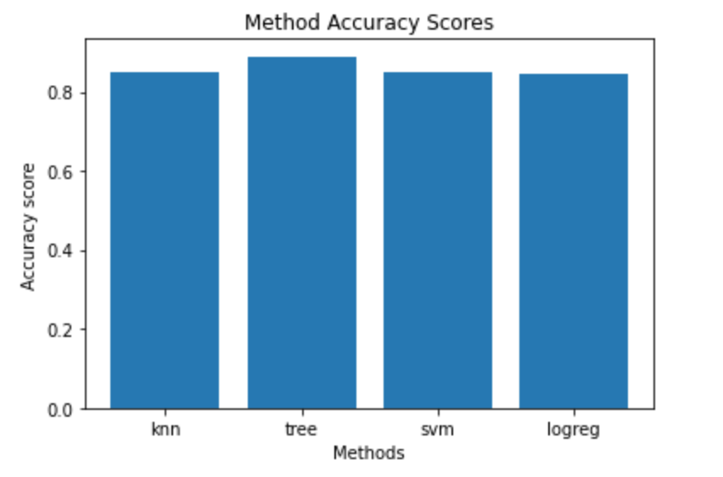
Executive Summary
Summary of methodologies:
Data was scraped from the SpaceX URL using Beautiful Soup
Data was then wrangled to fill nulls and organize data
EDA was undertaken to determine key relationships between data
Foilum was used to build a map of sites
A number of different prediction models were trialled to find the optimum predictor
Accuracy score summarized below

Slide 4
Introduction
In this capstone, we will predict if the Falcon 9 first stage will land successfully.
SpaceX advertises Falcon 9 rocket launches on its website with a cost of 62 million dollars; other providers cost upward of 165 million dollars each, much of the savings is because SpaceX can reuse the first stage.
Therefore if we can determine if the first stage will land, we can determine the cost of a launch. This information can be used if an alternate company wants to bid against SpaceX for a rocket launch.

Slide 5

Section 1

Slide 6
Methodology
Executive Summary
Data collection methodology:
Scraped from the SpaceX URL using Beautiful Soup
Perform data wrangling
Filling nulls and identifying key data points
Perform exploratory data analysis (EDA) using visualization and SQL
Perform interactive visual analytics using Folium and Plotly Dash
Perform predictive analysis using classification models

Slide 7
Data Collection – SpaceX API
Data was collected from the SpaceX API URL as per flowchart opposite.
GitHub URL of the completed SpaceX API calls notebook:
https://github.com/morriol/IBM-DS-Capstone/blob/main/jupyter-labs-spacex-data-collection-api.ipynb
Flowchart of SpaceX API calls here
Identify SpaceX API URL
Decode response as a json and convert to dataframe
Use requests.get to pull data
Import requests library

Slide 8
Data Collection - Scraping
Data was collected from the SpaceX API URL as per flowchart opposite.
URL to git hub repo
https://github.com/morriol/IBM-DS-Capstone/blob/main/jupyter-labs-webscraping.ipynb
Flowchart of web scraping
Request Falcon 9 launch page
Extract column/variable names from html table headers
Create Beautiful Soup object
Import Beautiful Soup
Create data frame by parsing html tables

Slide 9
Data Collection - Wrangling
Data was wrangled as per flow chart opposite.
URL to git hub repo
https://github.com/morriol/IBM-DS-Capstone/blob/main/labs-jupyter-spacex-Data%20wrangling.ipynb
Flowchart of data wrangling
Calc number and occurrence of each orbit
Create a landing outcome label from Outcome column
Calc the number and occurrence of mission outcome per orbit type
Calc number of launches per site

Slide 10
EDA with Data Visualization
Summary of charts plotted and why used:
Scatter plot of flight number and payload mass with launch outcome to identify clusters of mass and flight number associated with successful launches
Scatter plot of flight number and site with launch outcome to identify clusters of sites and flight number associated with successful launches
Scatter plot of mass and site with launch outcome to identify clusters of sites and mass associated with successful launches
Bar chart to identify relationship between orbit and success rate
Line chart to examine success rate over time
GitHub URL:
https://github.com/morriol/IBM-DS-Capstone/blob/main/jupyter-labs-eda-dataviz.ipynb

Slide 11
EDA with SQL
SQL queries performed:
Display unique launch sites
Display 5 records where launch sites begin with the string 'CCA'
Display the total payload mass carried by boosters launched by NASA (CRS)
Display average payload mass carried by booster version F9 v1.1
List the date when the first successful landing outcome in ground pad was achieved
List the names of the boosters which have success in drone ship and have payload mass greater than 4000 but less than 6000
List the total number of successful and failure mission outcomes
List the names of the boosterversions which have carried the maximum payload mass
List the records which will display the month names, failure landing outcomes in drone ship ,booster versions, launch site for the months in year 2015.
Rank the count of successful landing outcomes between the date 04-06-2010 and 20-03-2017 in descending order.
GitHub URL of completed EDA:
https://github.com/morriol/IBM-DS-Capstone/blob/main/jupyter-labs-eda-sql-coursera_sqllite.ipynb

Slide 12
Predictive Analysis (Classification)
Model development process:
Created models using logistic regression, SVM, KNN and Classification Tree to predict classification (success/failure) of future launches
Parameters were optimized using GridSearchCV
Plotted a confusion matrix to identify types of errors being made by the model
GitHub URL of completed predictive analysis lab
https://github.com/morriol/IBM-DS-Capstone/blob/main/SpaceX_Machine%20Learning%20Prediction_Part_5.ipynb

Slide 13
Results
Exploratory data analysis results
Interactive analytics demo in screenshots
Predictive analysis results

Slide 14

Section 2

Slide 15
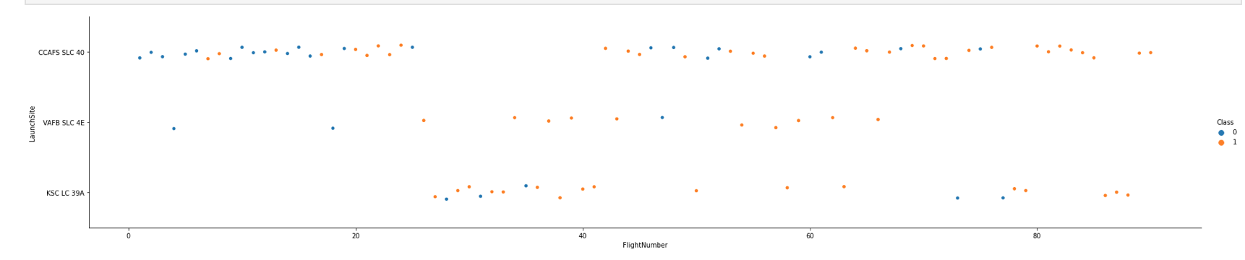
Flight Number vs. Launch Site

Slide 16
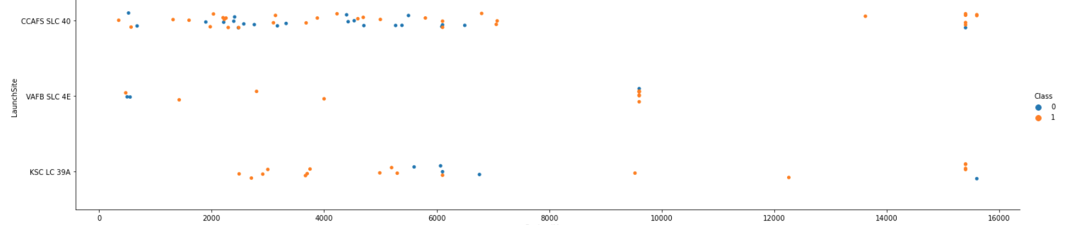
Payload vs. Launch Site

Slide 17
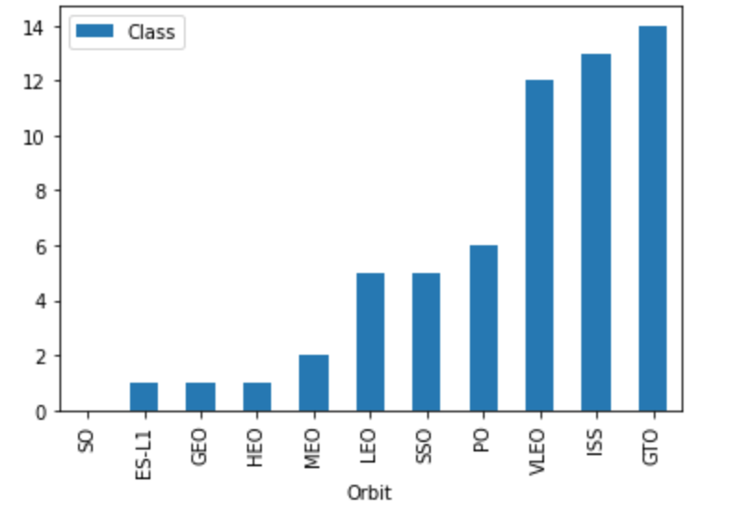
Success Rate vs. Orbit Type

Slide 18
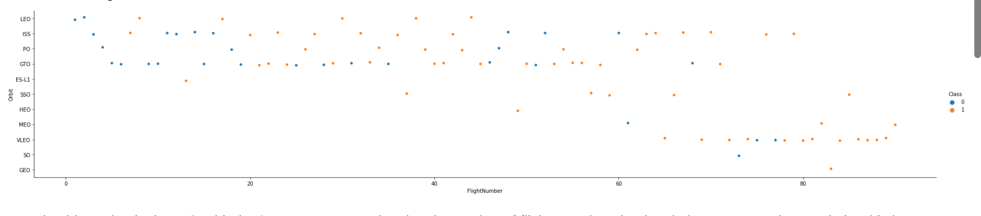
Flight Number vs. Orbit Type

Slide 19
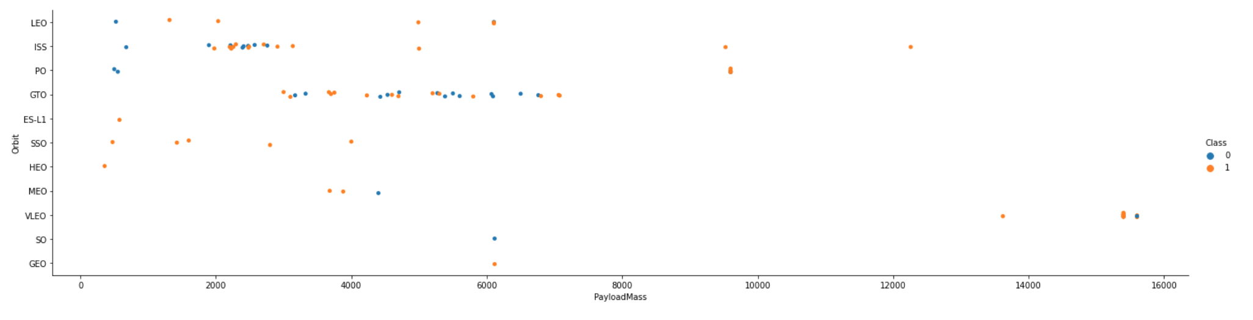
Payload vs. Orbit Type

Slide 20
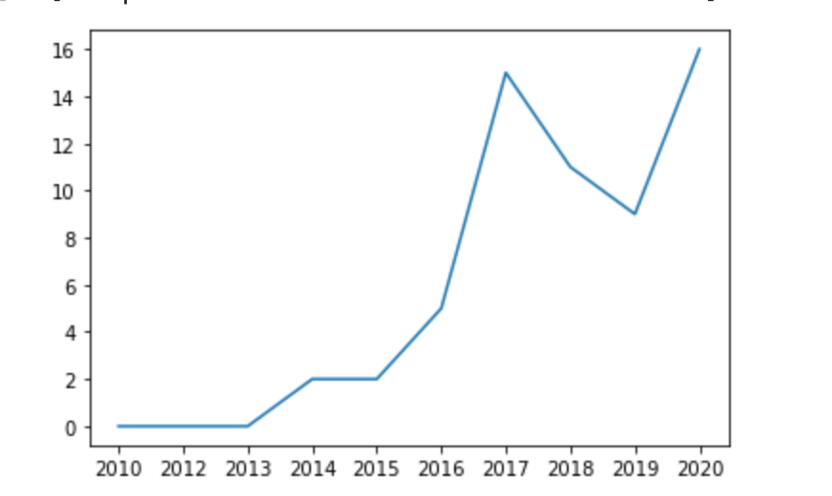
Launch Success Yearly Trend

Slide 21
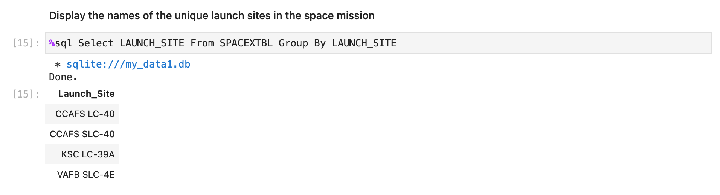
All Launch Site Names

Slide 22
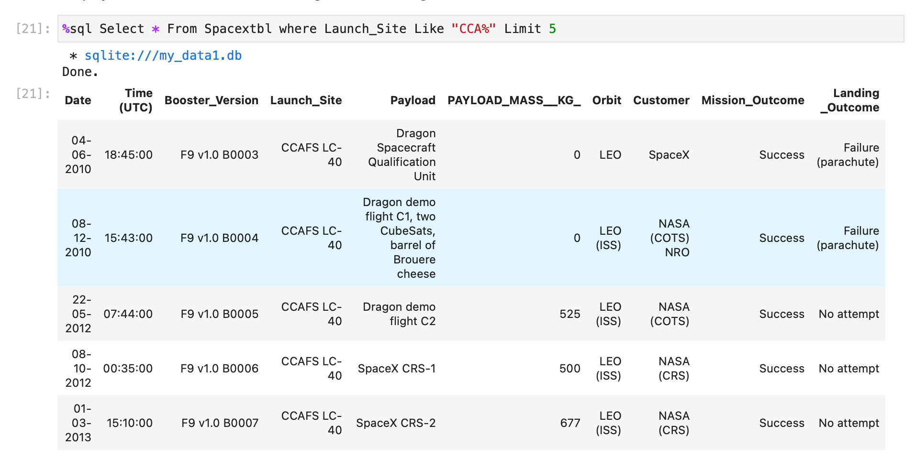
Launch Site Names Begin with 'CCA'

Slide 23
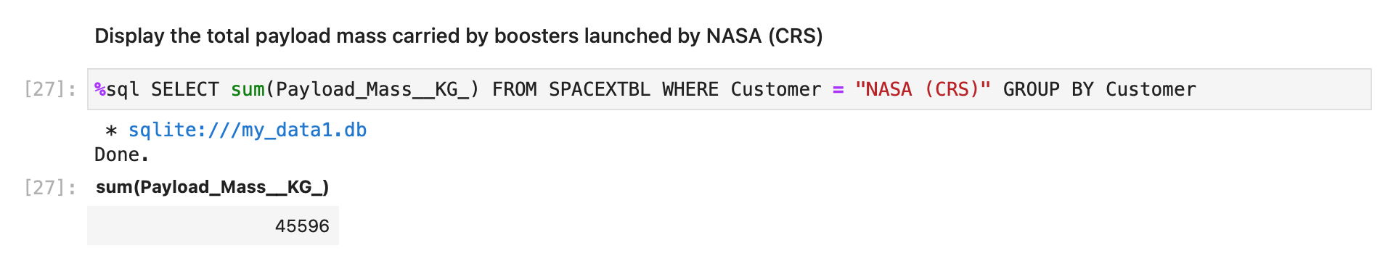
Total Payload Mass

Slide 24
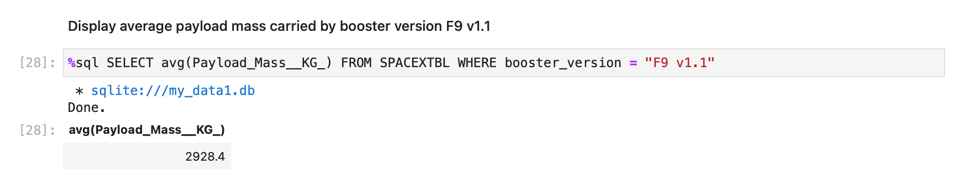
Average Payload Mass by F9 v1.1

Slide 25
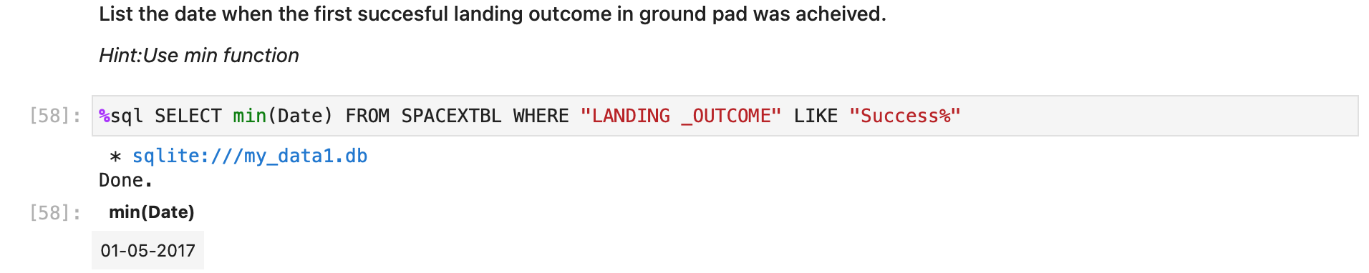
First Successful Ground Landing Date

Slide 26
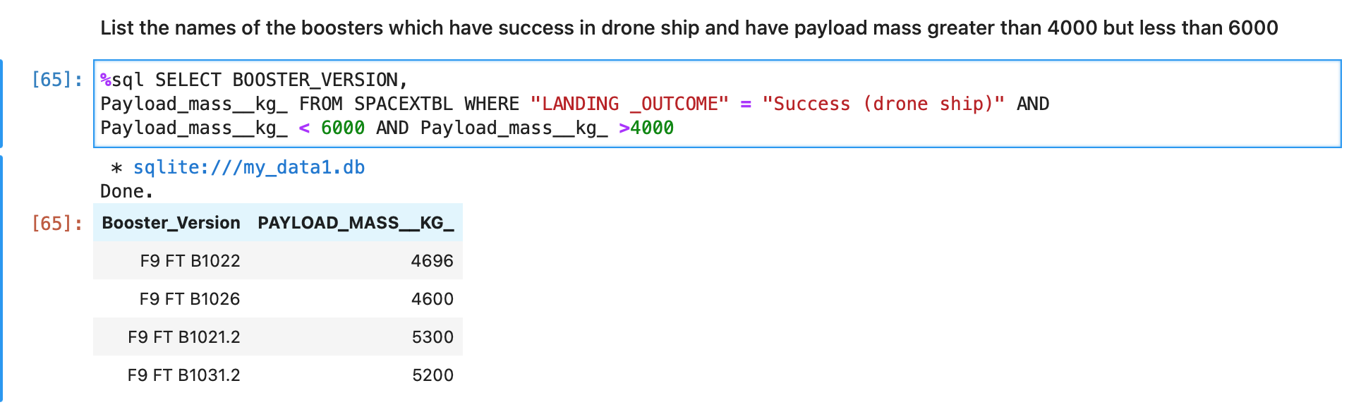
Successful Drone Ship Landing with Payload between 4000 and 6000

Slide 27
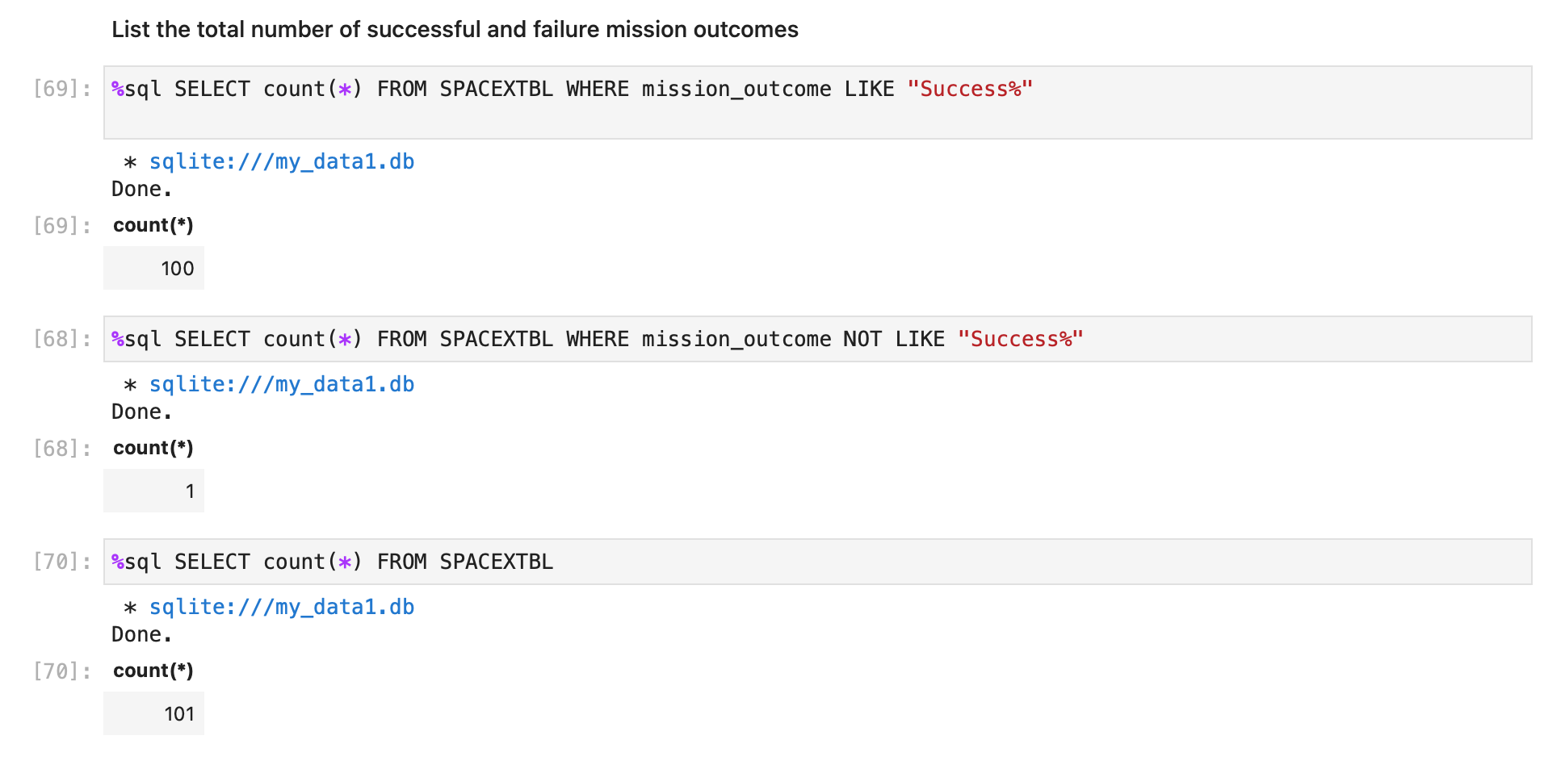
Total Number of Successful and Failure Mission Outcomes

Slide 28
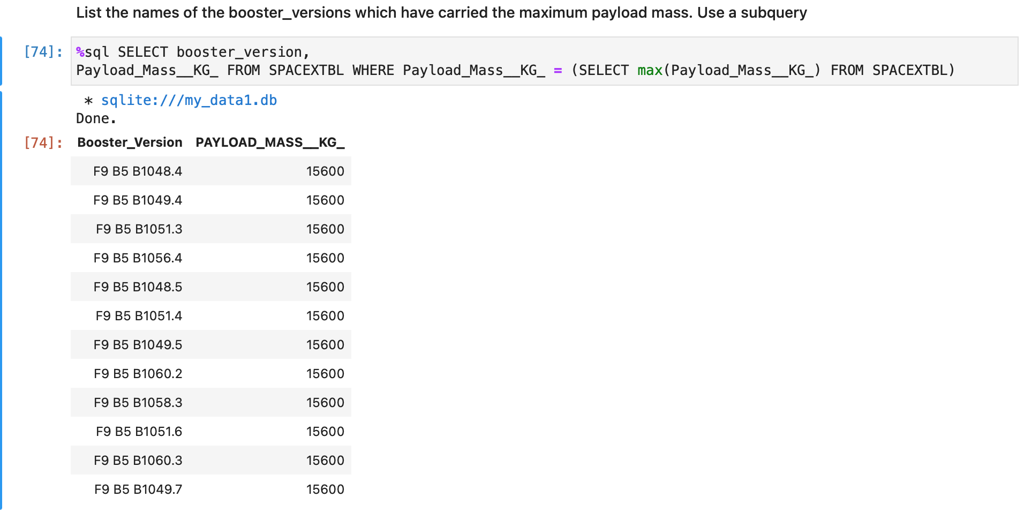
Boosters Carried Maximum Payload

Slide 29
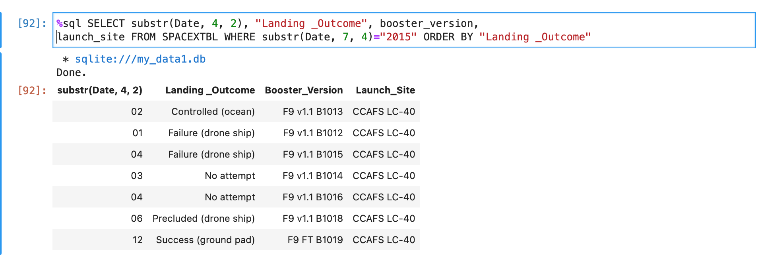
2015 Launch Records

Slide 30
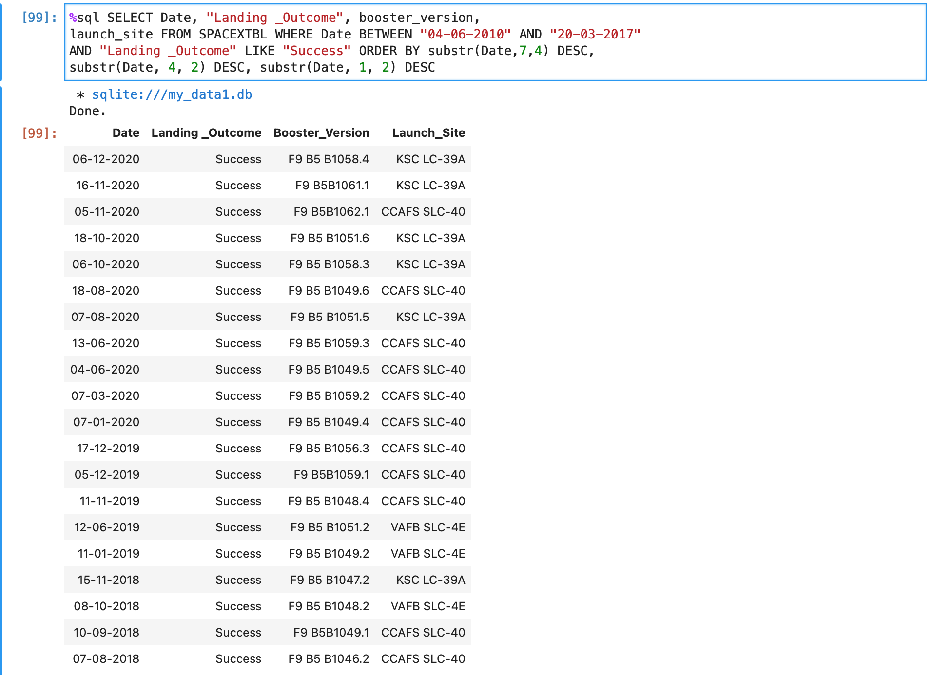
Rank Landing Outcomes Between 2010-06-04 and 2017-03-20

Slide 31

Section 3

Slide 32
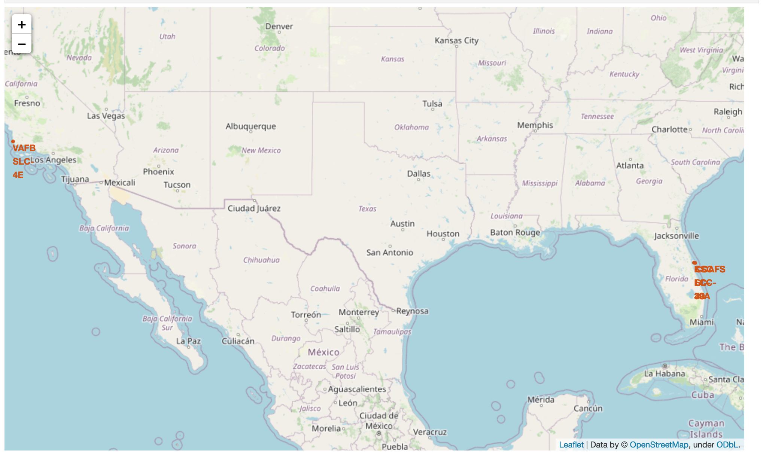
Folium Map of launch sites

Slide 33

Section 4

Slide 34
Unable to complete Dashboard Section as no access to IBM cloud

Slide 35

Section 5

Slide 36
Classification Accuracy
Classification tree has the best accuracy score

Slide 37
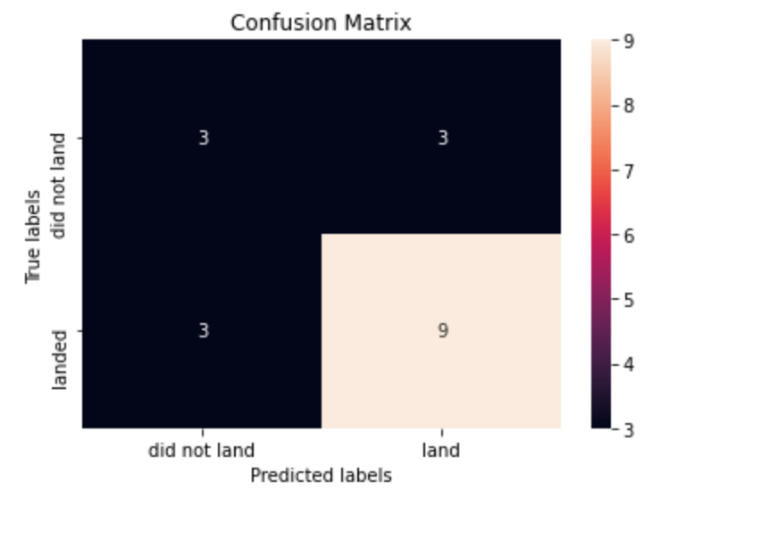
Confusion Matrix
This is the confusion matrix for the classification tree model.
It shows the model correctly predicted 9/12 (true positive) landings and 3/6 (true negative) failures.

Slide 38
Conclusions
Point 1: Using data wrangling and feature engineering we we able to build models with a high degree of accuracy – all with a score +80%
Point 2: Whilst classification tree had the best accuracy other models log_reg, svm and knn all had better precision and recall
Point 3: Therefore knn or svm may be better choices as models to use for prediction

Slide 39


